Slide 1
What is Natural Language Processing (NLP)
The process of computer analysis of input provided in a human language (natural language), and conversion of this input into a useful form of representation.
The field of NLP is primarily concerned with getting computers to perform useful and interesting tasks with human languages.
The field of NLP is secondarily concerned with helping us come to a better understanding of human language.
NLP is subfield of Artificial Intelligence. It is used to identify meaning of words and sentences in natural language. It also helps computers to understand human languages in better way.

Slide 2
Forms of Natural Language
The input/output of a NLP system can be:
  written text
  speech
We will mostly concerned with written text (not speech).
To process written text, we need:
  lexical, syntactic, semantic knowledge about the language
  discourse information, real world knowledge
To process spoken language, we need everything required to process written text, plus the challenges of speech recognition and speech synthesis.

Slide 3
NLP Applications
Search Engine
Opinion Mining
Sentiment analysis
Chatbot
Document/text classification
Machine Translation
Recommendation
Social Network Analysis
Spelling and grammar check

Slide 4
Components of NLP
Natural Language Understanding
  Mapping the given input in the natural language into a useful representation. The meaning of spoken/typed language is found.
  Different level of analysis required:
  syntactic analysis,
  semantic analysis
Natural Language Generation
  Producing output in the natural language from some internal representation.
  Different level of synthesis required:
  deep planning (what to say),
  syntactic generation
NL Understanding is much harder than NL Generation. But, still both of them are hard.

Slide 5
Phases of NLP
Tokenization – Create tokens from sentence
Stemming – Normalize words into base form
Lemmatization – Output different words into single word. E.g. went, gone into go, better, best----- good
POS Tags- Dividing Sentence into Noun, Verb etc.
Named Entity Recognition – dividing sentence in different entities.

Slide 6
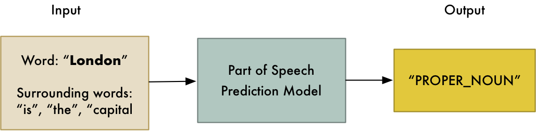
POS Tagger

Slide 7
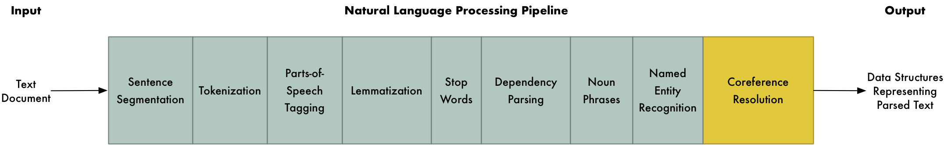
NLP Pipeline

Slide 8
Language Processing
Level 1 – Speech sound (Phonetics & Phonology)
Level 2 – Words & their forms (Morphology, Lexicon)
Level 3 – Structure of sentences (Syntax, Parsing)
Level 4 – Meaning of sentences (Semantics)
Level 5 – Meaning in context & for a purpose (Pragmatics)
Level 6 – Connected sentence processing in a larger body of text (Discourse)

Slide 9
Libraries
NLTK
Scikit – learn
Spacy

